Slide 1
Bank Management System
Arpita Vaish: 2200290140038
Arpit VISHWAKARMA: 2200290140037

Slide 2
Abstract
The bank management system project is a program that keeps track of a client’s bank account. This project demonstrates the operation of a banking account system and covers the essential functions of bank management software. It develops a project for resolving a customer’s financial applications in a banking environment to meet the needs of an end banking user by providing multiple ways to complete banking chores. Additionally, this project is to provide additional features to the user’s workspace that are not available in a traditional banking project. The project’s bank management system is built on cutting-edge technologies. This project’s main goal is to create software for a bank account management system. This project was designed to make it simple and quick to complete previously impossible processes with manual systems which are now possible with this software. In this project we are using Java programming language for coding purposes and MySQL for database management. The database has account table, customer table and admin table.

Slide 3
Introduction
Using the technologies of Java, Swing, JDBC and MySQL, the Banking management system project was created. Since it features both connectivity—i.e., frontend and backend—the project is nicely constructed. The Project is constructed on a platform that uses the Eclipse IDE version 18, and MySQL Workbench version 8.1 CE, for connectivity from the front end to the back end. The Project's User Interface (UI) was created using Java's Swing, AWT as well as a variety of Java objects, and it is very user-friendly, making it suitable for all types of people to utilize.
It is used by banks and other financial institutions to manage their continuous business operations, customer accounts, transactions, and other associated duties. The project was entirely created using the fundamental ideas of Java, specifically the Oops (Object Oriented Programming) philosophy. Each function is easy to access and well-organized.
Important components of a bank management system:
Customer Management: The system gives the bank the ability to manage customer data, including identifying data, account opening, account closure, and account maintenance.
Account management permits the opening and maintenance of many different types of accounts, including loans, savings accounts, checking accounts, and accounts for fixed deposits. It can manage balances, compute interest, keep track of transactions, and produce statements, among other things.
Payments, transfers, withdrawals, and deposits are just a few of the various transaction types that can be processed by the system. It ensures secure transaction processing and preserves trustworthy audit trails.

Slide 4
Project Objective
The objective of the Bank Management System project is to design and implement a comprehensive software solution that streamlines and enhances the day-to-day operations of a bank. This system aims to:
1. Automate core banking processes: Develop a user-friendly interface to automate tasks such as customer management, account handling, and transaction processing to improve operational efficiency.
2. Enhance customer experience: Provide a secure and convenient platform for customers to access their accounts, make transactions, and receive banking services, thereby improving customer satisfaction.
3. Ensure data security: Implement robust security measures to safeguard sensitive financial data, prevent unauthorized access, and protect against cyber threats.
4. Enable scalability: Design the system to accommodate future growth and evolving banking needs by allowing easy integration of new services and features.
5. Improve decision-making: Provide comprehensive reporting and analytics tools to assist bank management in making informed decisions based on real-time data.

Slide 5
Modules
Here in my project there are two types of modules. This module is the main module which performs all the main operations in the system. The major operations in the system are:
Admin Module
User module

Slide 6
Admin Module
Admin can access this project there is an authorization process. If you login as an Admin then you will be redirected to the Admin Home Page and if you are a simple user you will be redirected to your Account Home Page. This performs the following functions. Create Individual Accounts, manage existing accounts, View all transactions, Balance enquiry, Delete/close account etc.
Admin login
Add/delete/update account
Withdrawal/deposit/statements transaction
Account Information
User details list
Active/Inactive account
View transaction histories

Slide 7
User Module
A simple user can access their account and can deposit/withdraw money from their account. User can also transfer money from their account to any other bank account. User can see their transaction report and balance enquiry too.
User login, use PIN system
Creating/open new account registration
View statements transaction
User account details
Change Password and Pin

Slide 8
Requirements
Hardware Requirements:
Laptop or PC
Minimum 1GB RAM,128GB internal
I3 Processor
Software Requirements:
IntelliJ Idea IDE or NetBeans
My SQL or JDBC server

Slide 9
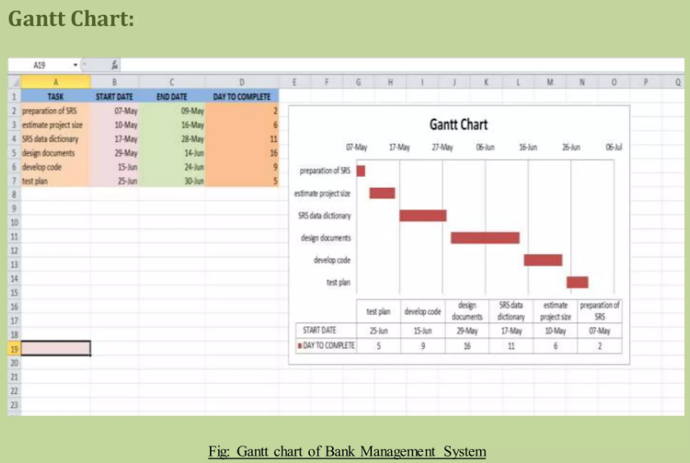
Gantt Chart:

Slide 10
Conclusion
Bank Management System have evolved significantly over the years, offering financial institutions the means to enhance efficiency, customer experience, and compliance. However, they also face challenges, particularly in terms of cybersecurity and regulatory compliance. Emerging trends in technology, such as, AI, blockchain, open banking and cloud computing, continue to shape the future of these systems.

